Slide 1
State Voting and Governor Influence in the 2016 Election
Ben Harwood

Slide 2
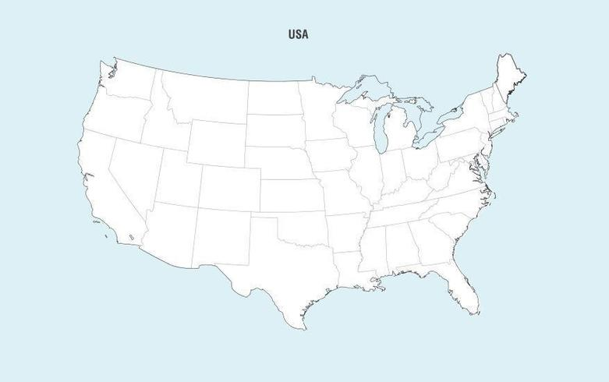

Slide 3
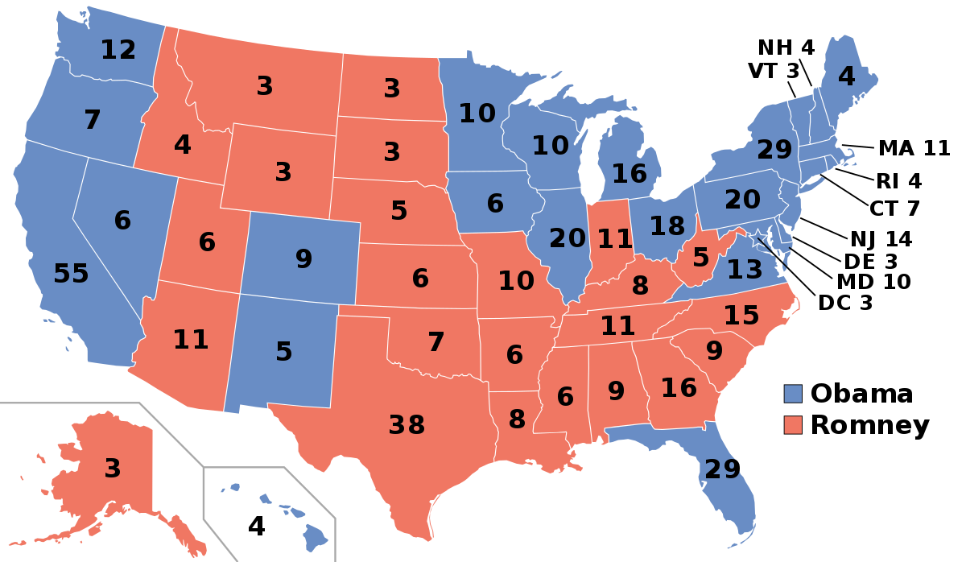

Slide 4
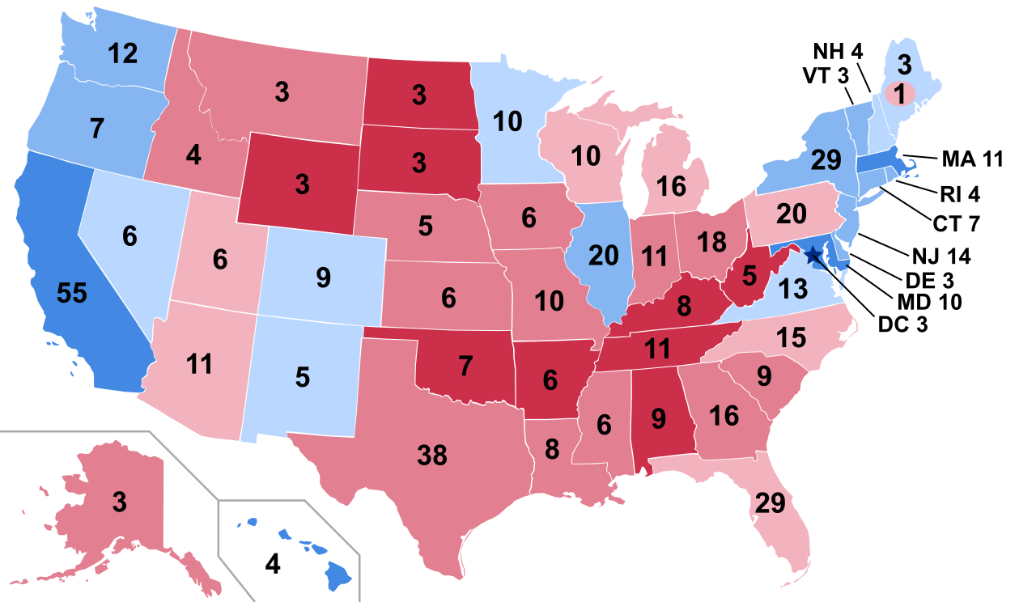
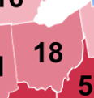

Slide 5

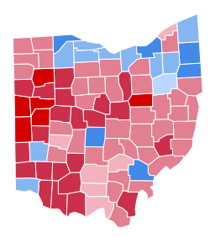
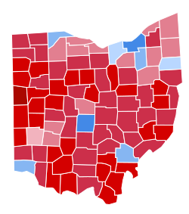
2012
2016

Slide 6



Questions of
Interest
Agenda

Slide 7
Data
Agenda
Questions of
Interest

Slide 8

Methods
Agenda
Data
Questions of
Interest

Slide 9
Methods
Agenda
Data

Slide 10
Agenda
Methods
Data

Slide 11
Results
Agenda
Methods
Data

Slide 12
Agenda
Results
Methods

Slide 13
Questions
Agenda
Results

Slide 14
Agenda
Questions
Results

Slide 15
Agenda

Slide 16
Questions of
Interest

Slide 17
Questions of
Interest

Slide 18
Data
Questions of
Interest
How many counties in each state switched parties in the 2016 election?
(Part 1)
Does the average median income in a state influence how a state votes, and/or how many counties in the state switched parties?
How many counties and states did not vote along the party line of their governor?
Is there a relationship between the party of the governor and how the state voted in 2016?

Slide 19
Questions of
Interest
Data
(Part 1)
3,143 counties, 159 variables
State abbreviation
Fips – Federal Information Processing Standards, each county has a unique Fips id associated to it in the dataset, used for matching and referencing purposes
County
Democrats 12 (Votes) – number of votes in the county for the democrat in 2012 (Obama)
Republicans 12 (Votes) – number of votes in the county for the republican in 2012 (Romney)
Votes16 Clintonh – number of votes in the county for Hillary Clinton in 2016
Votes16 Trumpd – number of votes in the county for Donald Trump in 2016
Median Earnings 2010

Slide 20
Data
Questions of
Interest
(Part 2)
What was the average sentiment for each party?
What states had the most and least positive speeches?
Which states (if any) had negative sentiment?
Does speech sentiment influence jump ratios?

Slide 21
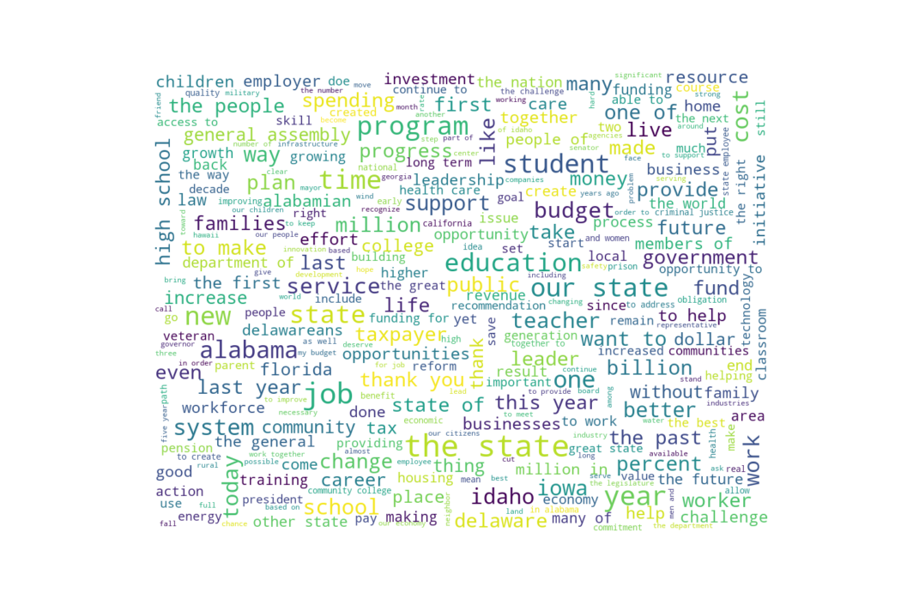
Methods &
Results
Questions
Data
(Part 2)
State of the state speeches from 2016 for 36 states

Slide 22
Methods &
Results
Function accepting a party and state that returns how vote counts by county, eg.
There are 62 counties in NY, with 26 of them voting republican in 2012, and 46 of them voting republican in 2016. Additionally, 26 of the 26 counties that voted republican in 2012 also voted republican in 2016.

Slide 23
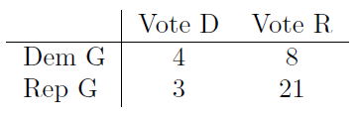

Methods &
Results
Overall, 69.44% of states voted for the party of their governor. Additionally, 33.33% of states with democrat governors voted for Hillary Clinton, while 87.50% of states with republican governors voted for Donald Trump.
The chi-square test is not significant, with p = 0.1365 so we fail to reject the null hypothesis that governor party and voting party are independent.

Slide 24
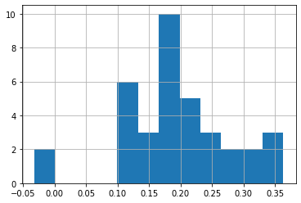
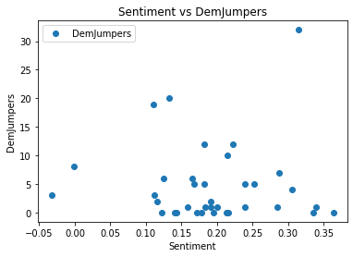
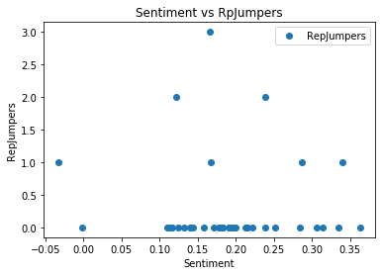
Questions?
Speech sentiment histogram
Methods &
Results
Does speech sentiment influence jump ratios?
Linear regression was performed to predict DemJumpers from Sentiment. Regression yields F(1, 35) = 13.47, p = 0.0007, R² = 0.257.
Considering the RepJumpers, regression yields F(1, 35) = 4.629, p = 0.0384, R² = 0.092.

Slide 25
Questions?

Slide 26
Questions?

Slide 27
References

Slide 28
Thank you

